Slide 1
Whiteboard Design
How to participate

Slide 2
Step 1: Get the Whiteboard App
Download the latest version of the Microsoft Whiteboard App
http://aka.ms/whiteboardapp
Sign in with the same credentials you log into Teams with for the conference.

Slide 3
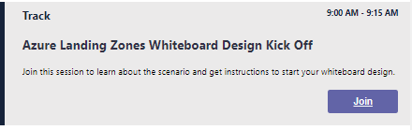
Step 2: Watch the kickoff session
Join the kickoff session to learn about the customer scenario and your objectives in participating in the whiteboard design.

Slide 4
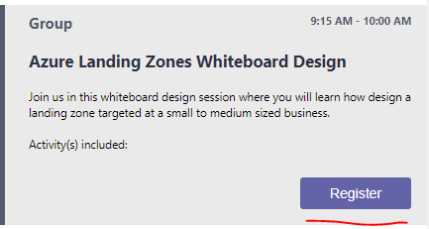
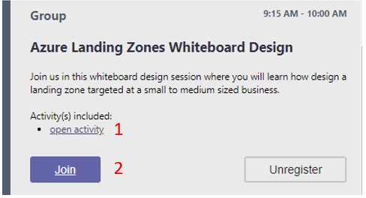
Step 3: Join your Team to Whiteboard
Click the register button to register your participation in a team.
Click the open activity link to view the attendee guide
Click the Join link to join your team

Slide 5
Step 4: Join the Whiteboard App Session and Start Designing
Your coach will add a link to the Team Meeting chat that will join you and the rest of your team to the same Whiteboard Design Session
From there, you and your team will collaborate to solve the challenges in the whiteboard design by drawing diagrams and answering all questions using the whiteboard app.

Slide 6
Step 5: Present Back to the Coach
After your team has completed your whiteboard design you will then present back to your coach.
Your coach will act as the customer you are presenting to and may challenge you with additional questions.

Slide 7
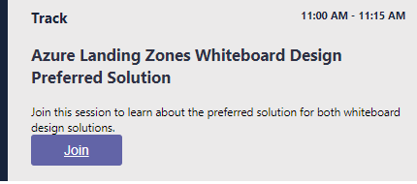
Step 6: Join the Preferred Solution
After the whiteboard design is over, join back for an all up team meeting to see the final preferred solution.

